Slide 2
AI

Slide 3
ChatGPT

Slide 4
10 Practical Applications for ChatGPT and GIS Integration
Notes:
“practical”

Slide 5
Per ChatGPT: 10 Reasons Why I’m Not Qualified to Present on ChatGPT
Can you help me list 10 reasons someone is not qualified to present on ChatGPT and GIS? It is for a funny slide in my presentation…
# | Reason | Qualification Lacking
1 | Thinks Excel is a new soft drink. | Technical Skills
2 | uses a flip phone for "emerging technology" reasons. | Tech Savviness
3 | Believes Ctrl+C and Ctrl+V are ancient hieroglyphics. | Basic Computer Skills
4 | Claims they have "extensive experience" in a video game. | Relevant Experience
5 | Thinks "Java" refers to a morning beverage. | Technical Language
# | Reason | Qualification Lacking
6 | Uses a magnifying glass to read digital text. | Visual Acuity
7 | Can't tell the difference between a "browser" and a "search engine." | Basic Digital Literacy
8 | Listens to heavy metal during meditation. | Focus and Attention
9 | Refers to themselves in the third person. | Professionalism
10 | Thinks "Google" is a synonym for "research." | Research Skills
Notes:
I'm not qualified to give this presentation, but that's the point, this is a natural language application, so you don’t need to be overly savvy with code, scripts, technology….

Slide 6
ChatGPT can provide instant explanations
You will have successes and failures
Apparently “very good" with coding and scripting
As GIS professionals, our ability to query databases gives us an edge in comprehending AI, as querying databases forms the foundation of AI interactions.
Use ChatGPT for troubleshooting hurdles; AI answers may not always be correct, but they proved valuable when addressing various challenges.
General Information

Slide 7
ChatGPT 3.5 is free; the last training was in 2022.
Data used to formula answers can be outdated.
ChatGPT 4.0's paid version offers updated training data and additional features.
Occasionally gives wacky, outdated, incomplete responses.
Ethical Challenges facing the AI industry
You are aware...?
Seinfeld Season 5 Episode 8 re: The Pensky File
Notes:
Almost 2 years old. 90+% % of requests are using ChatGPT 3.5 for this presentation. requests are real scenarios where I’ve used ChatGPT.

Slide 8
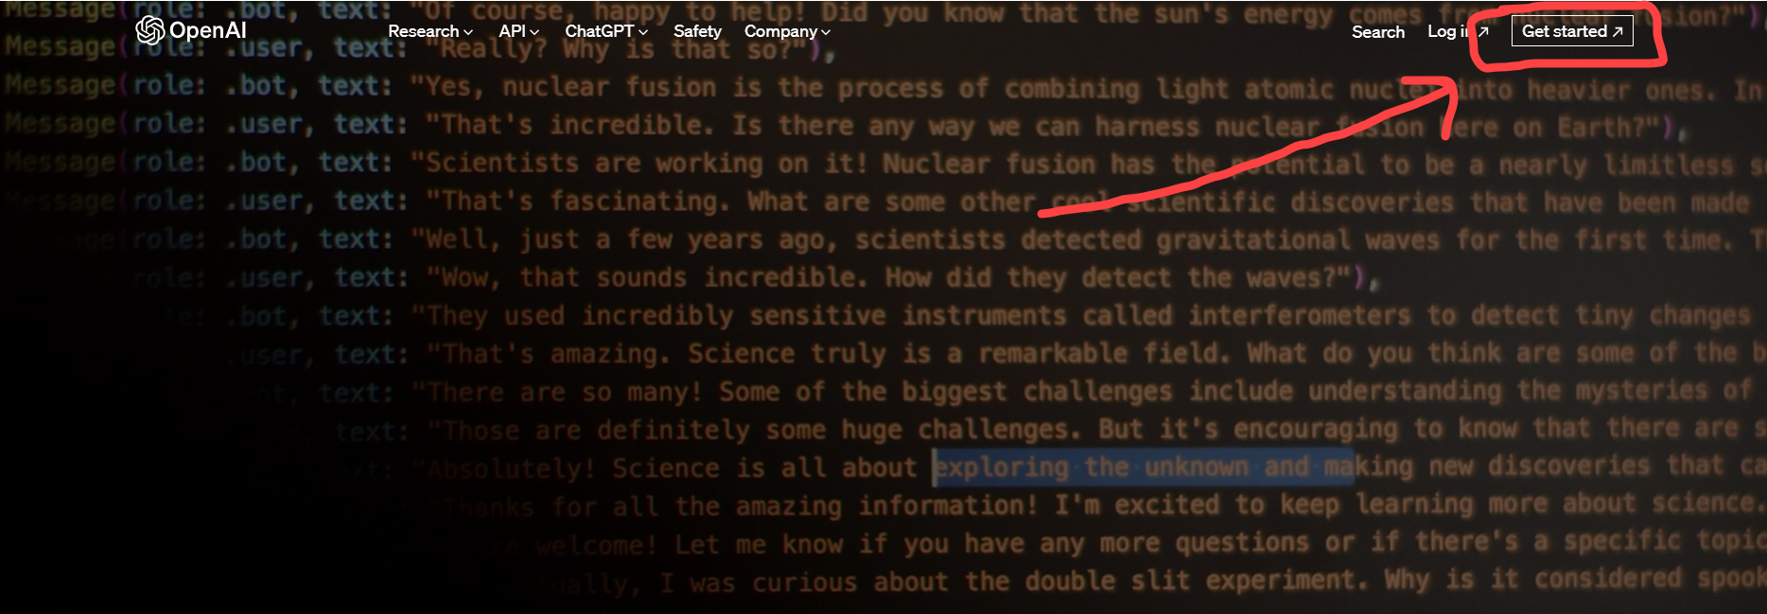
openai.com

Slide 9
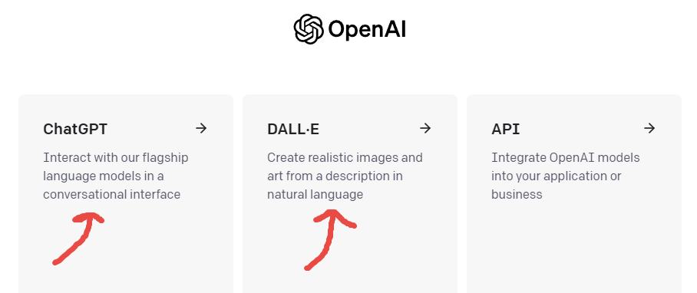

Slide 10
# 1 Empowering Email Communication
Can you make this email friendlier and more concise?

Slide 11
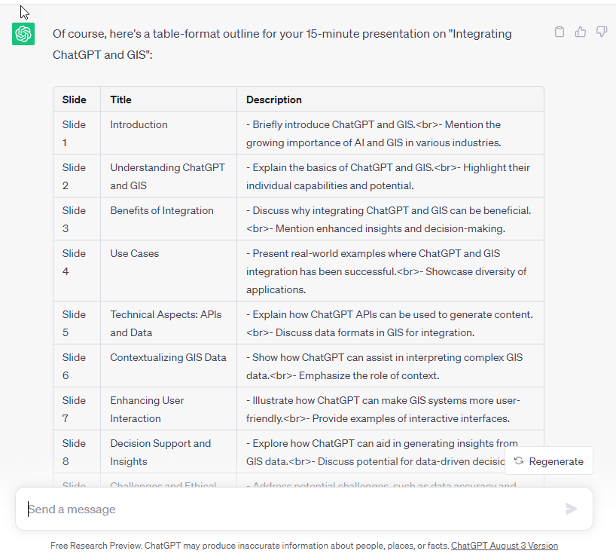
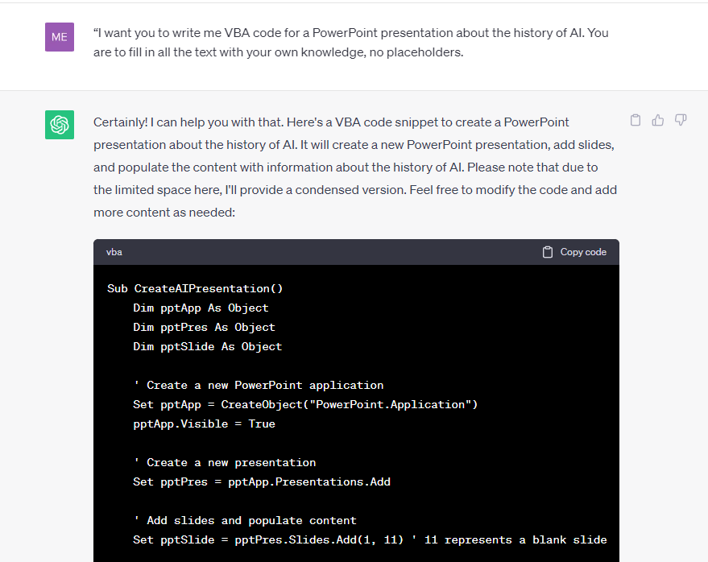
#2 Creating Presentations
Can you help create a 15-minute presentation on integrating ChatGPT and GIS? Please show a list with each slide's title and description in a table format.
I want you to write me VBA code for a Powerpoint presentation about the history of AI. You are to fill in all the text with your own knowledge, no placeholders.

Slide 12
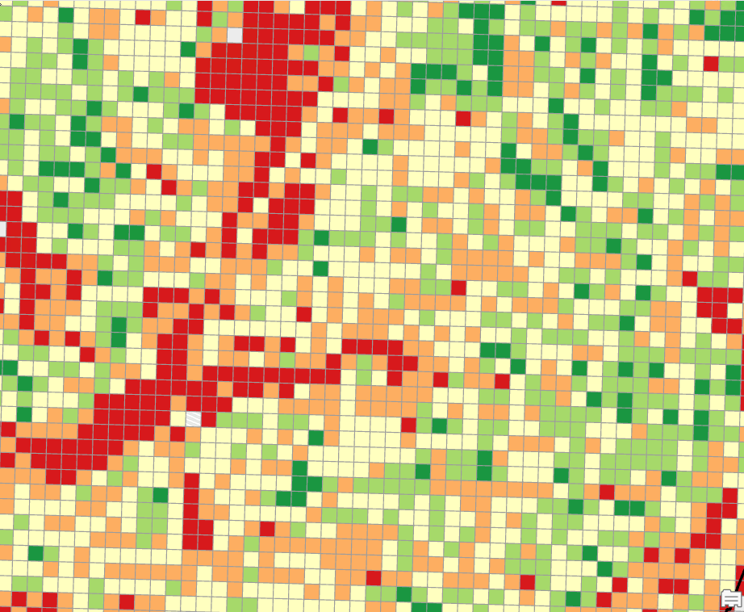
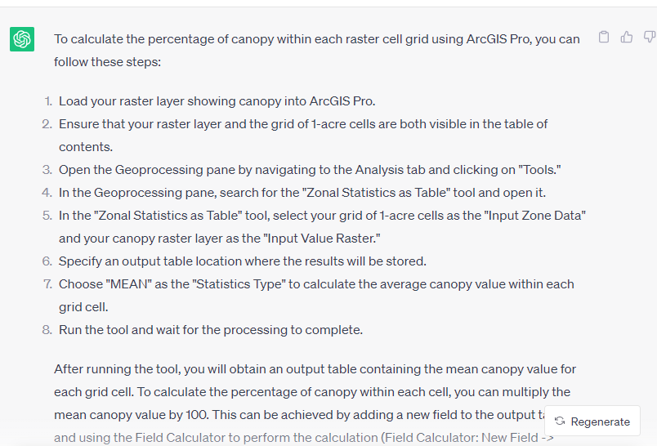
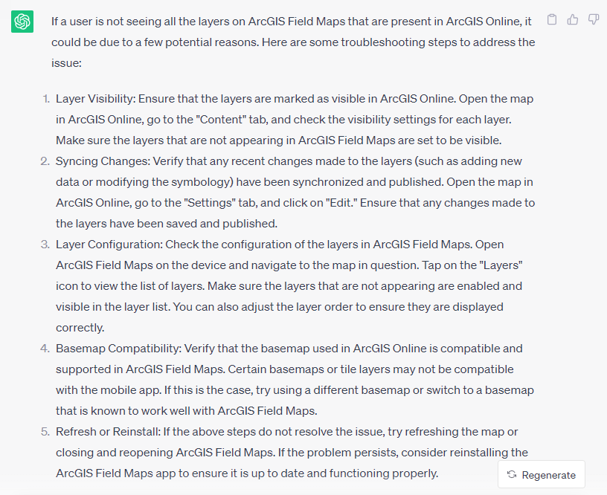
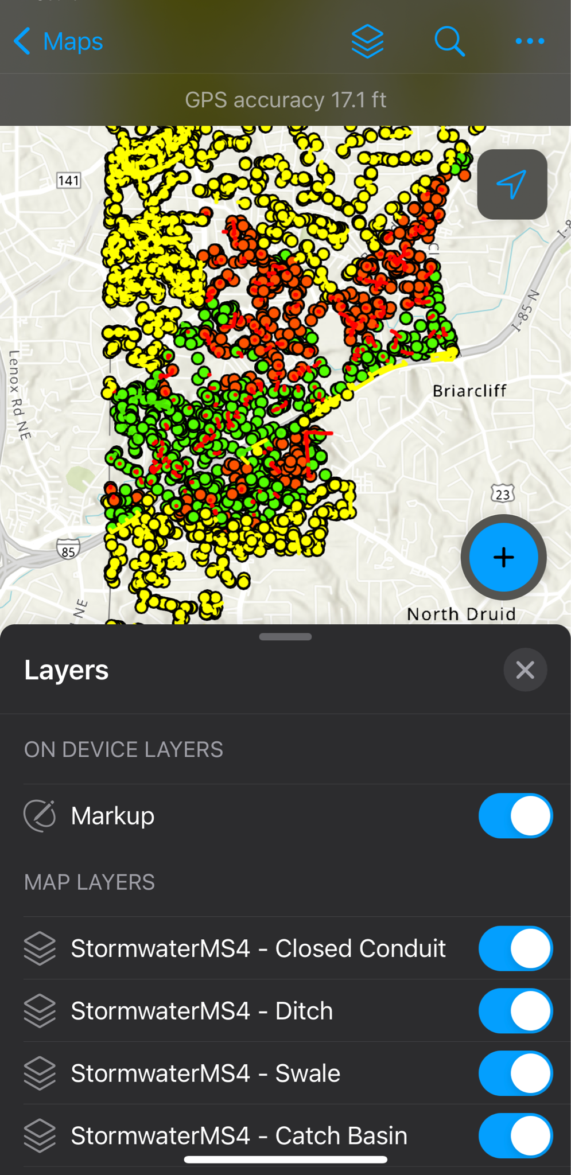
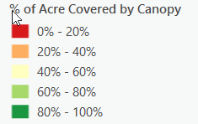
#3 - ArcGIS Knowledge and Step-by-Step Instructions
I have a grid of 1-acre cells. I also have a raster layer showing the tree canopy. Please tell me how to calculate the percent canopy within each raster cell grid.
ArcGIS Online: The user is not seeing all the layers show up on their ArcGIS Field Maps, can you give me a couple of ideas to troubleshoot?

Slide 13
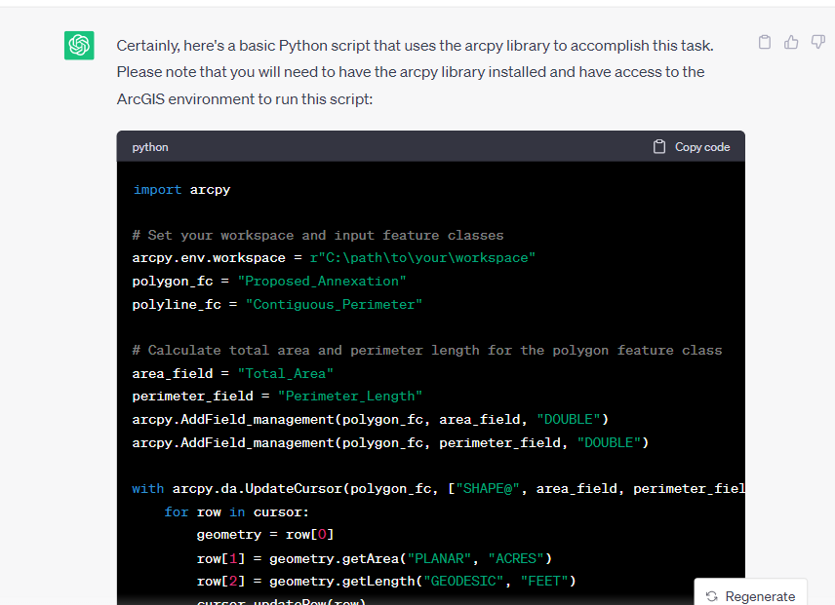
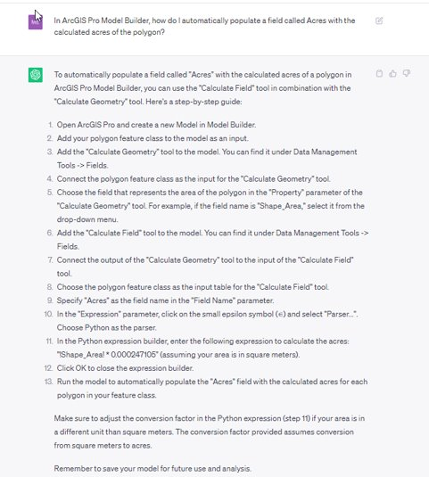
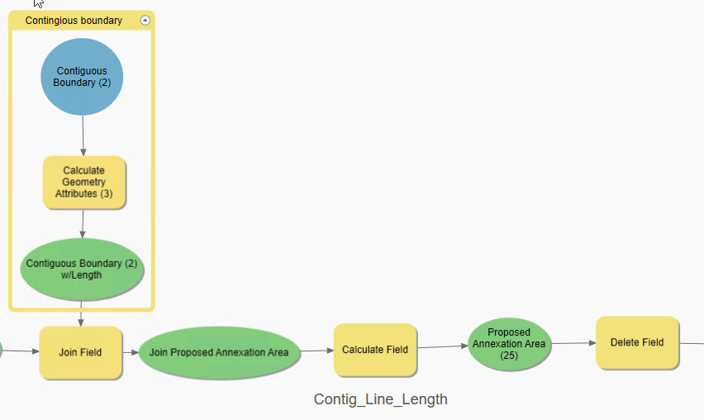
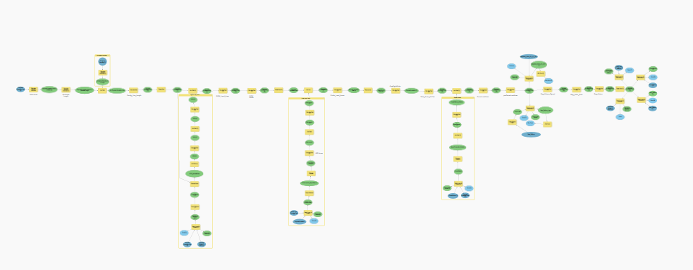
#4 Help with Python & ModelBuilder
Please provide a Python script for the following tool: The tool inputs are a polygon and a polyline feature class. The output for the polygon is the total area in acres, and the output for the polyline is the perimeter length in feet.
In ArcGIS Pro Model Builder, how do I automatically populate a field called Acres with the calculated acres from another polygon?

Slide 14
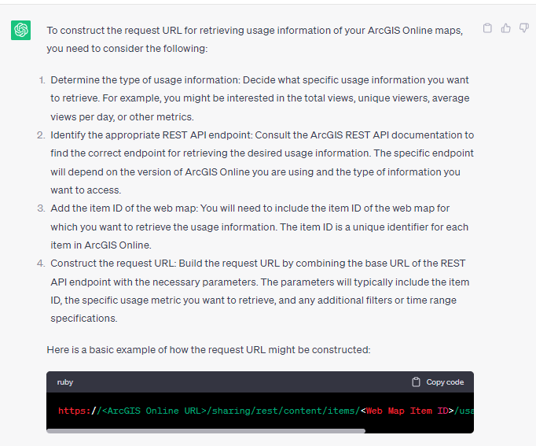
#5 Create a API Request
How do I construct a URL request to retrieve my organization’s ArcGIS Online map usage?

Slide 15
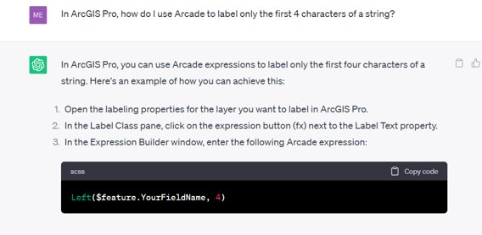
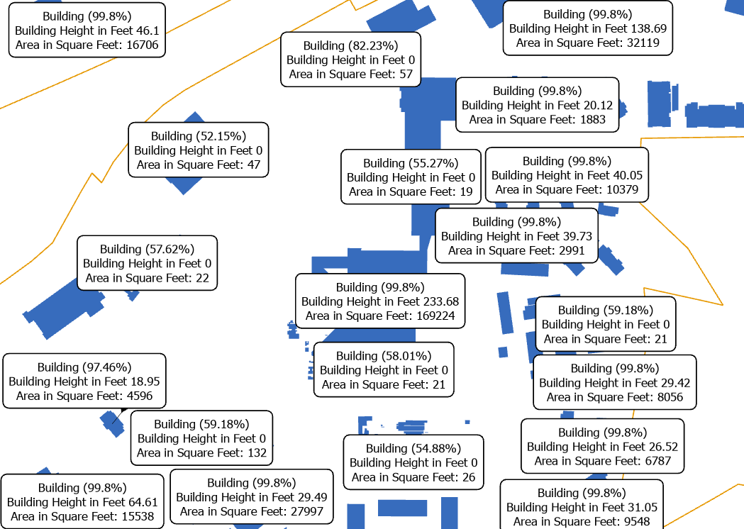
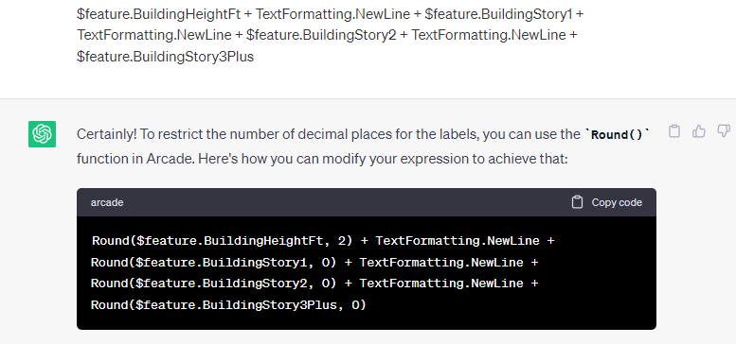
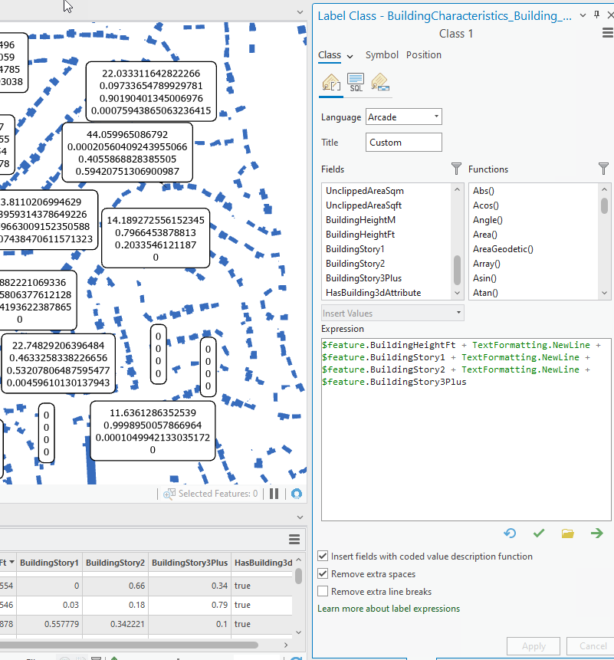
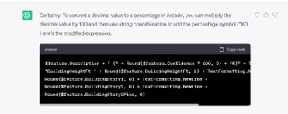
In ArcGIS Pro, how can I use Arcade to label only the first 4 characters of a string?
#6 Arcade Expressions (Labels)
Can you convert these results into a percentage?
Can you help me restrict the number of decimal places for these labels?

Slide 16
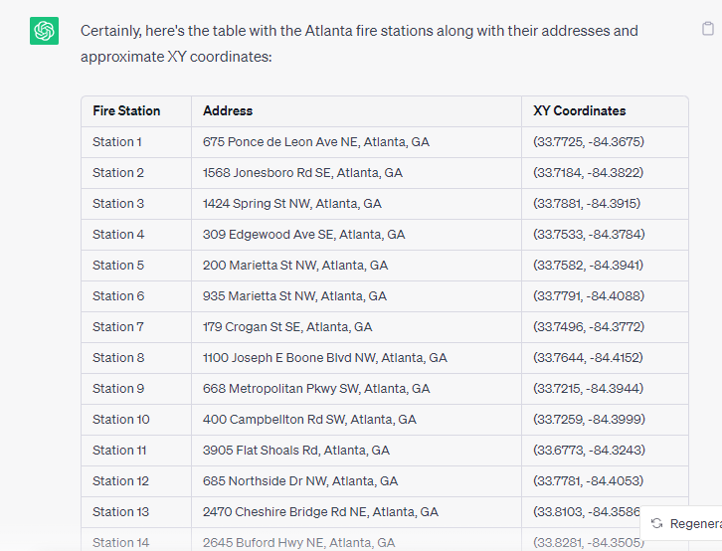
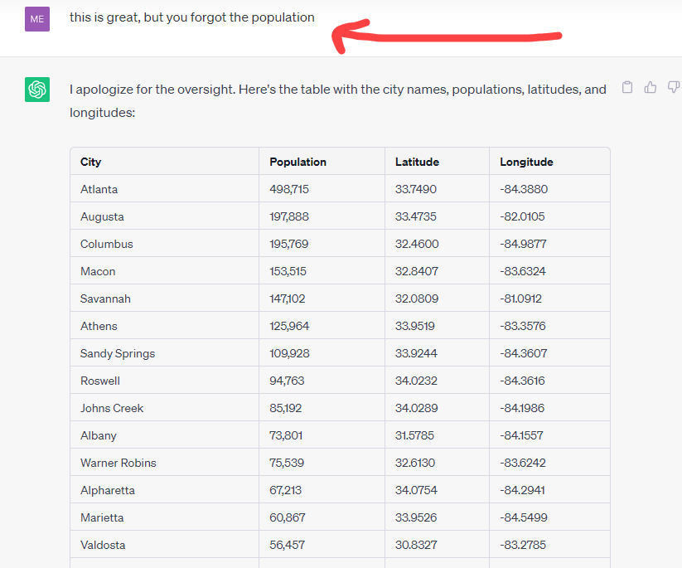
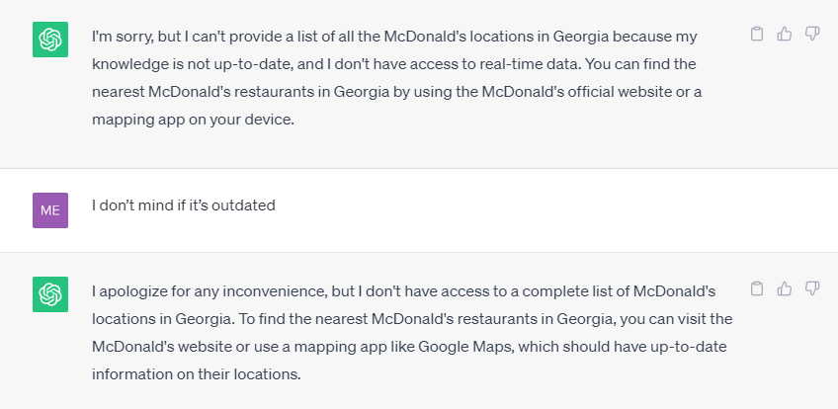
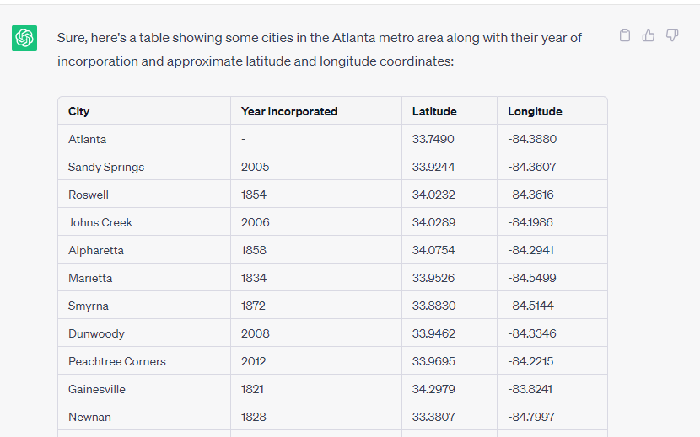
#7 Lists and Tables
Please list all the fire stations in Atlanta, GA, with XY Coordinates.
Please list the top 50 most populated cities in Georgia with population and the latitude and longitude in a table.
Can you list all the McDonald’s in Georgia?
Can you create a table showing all the cities in the Atlanta metro area with the year incorporated and the Lat / Long coordinate?

Slide 17
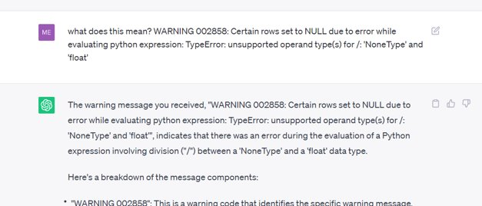
#8 Warning Errors & Debugging
Traceback error, huh?
WARNING 002858, really?

Slide 18
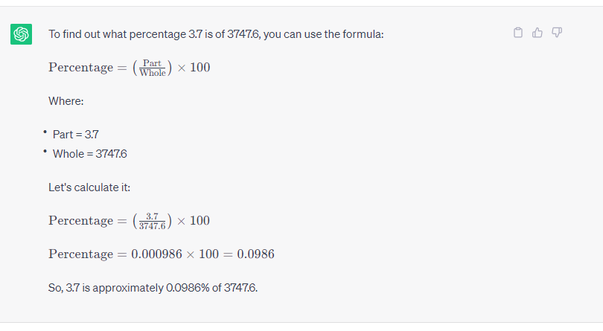
#9 Math (with detailed explanations)
Hey Siri, I mean whatever your name is, what percent is 3.7 acres of 3,747.6 acres?

Slide 19
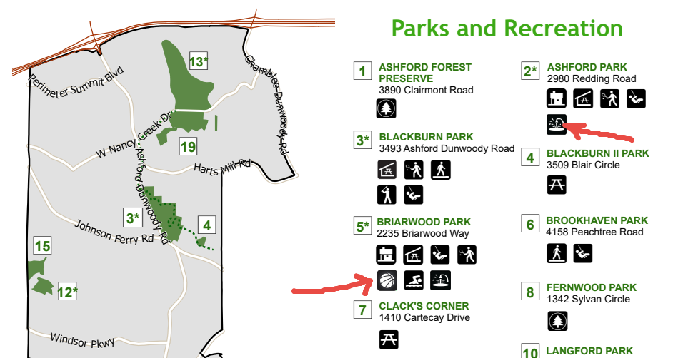
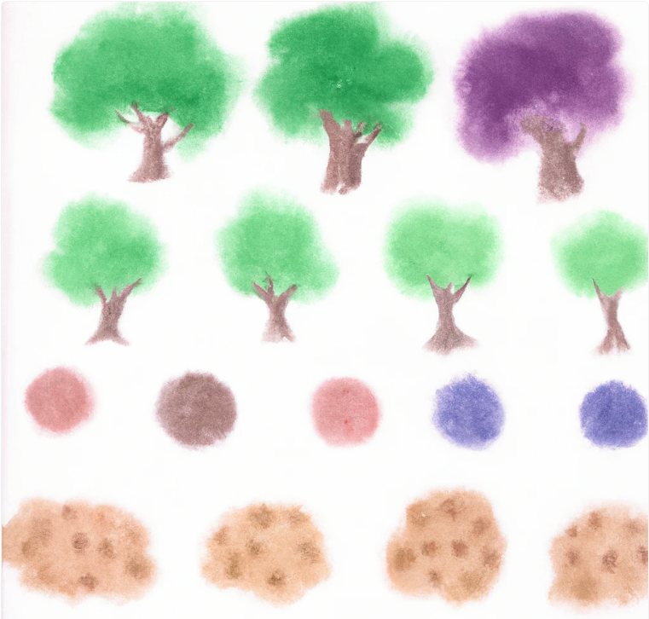
#10 Using Dall-E to Generate Map Icons
Create a watercolor Redwood tree icon.
Create a series of icons depicting a watercolor tree looking down on the tree from above. It should only show the canopy of the tree from the top.
Create a black and white icon with rounded corners showing a splash pad for a park map.
Create a black and white with rounded corners showing a basketball icon for use on a map.

Slide 20
Geocoding: addresses to coordinates or vice versa
Assist in crafting titles, names, legends, and bullet points
It will recommend good data sources
Translate the map into other languages
“ChatGPT Make me a map” – YouTube video
Bonus
Notes:
https://www.youtube.com/watch?app=desktop&v=65k-pmMf2Vg

Slide 21
Dall-E: A picture of a friendly AI robot with a black background using:
…
Digital Art
Surrealism
Renaissance
Pop Art
Cubism
Atlanta Region Geospatial Community Q3 2023 Meeting
Atlanta Regional Commission, September 6, 2023
Mike Edelson, PMP, GISP
City of Brookhaven GIS Manager
Not to Scale

